Slide 1
Using Big Data in An Activity-Based Model Speed Validation:
A San Diego Study
Wu Sun & Yun Ma
San Diego Association of Governments
2019 TRB Application Conference | June 5, 2019

Slide 2
Background
SANDAG maintains an Activity-Based Model (ABM) for regional plans
A few ABM modeling efforts use big data, including an experiment of using big data in speed calibration & validation
Mixed results from a 2012 base year speed calibration & validation, using INRIX speed data

Slide 3
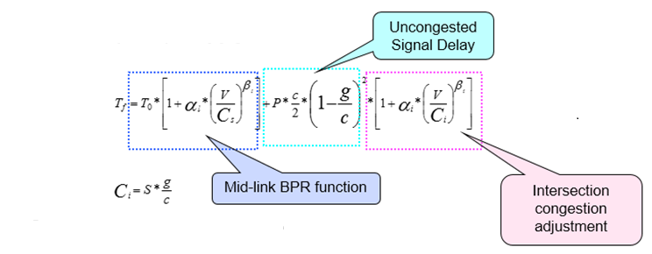
Methodology
Volume Delay Function
Calibrated Parameters
T₀: mid-link free flow travel time
α_{1:} mid-link alpha β_{1:} mid-link beta
Data Sources
October 2012 INRIX speed data

Slide 4
Parameter Calibrations
VDF Parameters
Roadway Function Class
 | Before |  | After
FC | α1 | β1 | α1 | β1
1,8,9 | 0.8 | 4 | 0.2 | 4
2,3 | 0.8 | 4 | 0.4 | 4
4,5,6,7 | 0.8 | 4 | 0.8 | 4
1 | Freeway
2 | Prime arterial
3 | Major arterial
4 | Collector
5 | Local collector
6 | Rural collector
7 | Local (non Circulation Element) road
8 | Freeway connector ramps
9 | Local ramps

Slide 5
Post Speed vs. Free Flow Speed
T₀: free flow travel time was derived from post speed
Post speed and free flow speed are different
Use 6:00-6:15 AM INRIX speed as free flow speed
Free flow speed is 3.5% higher than post speed on freeways
Free flow speed is 10% lower than post speed on other roads
Update T₀

Slide 6
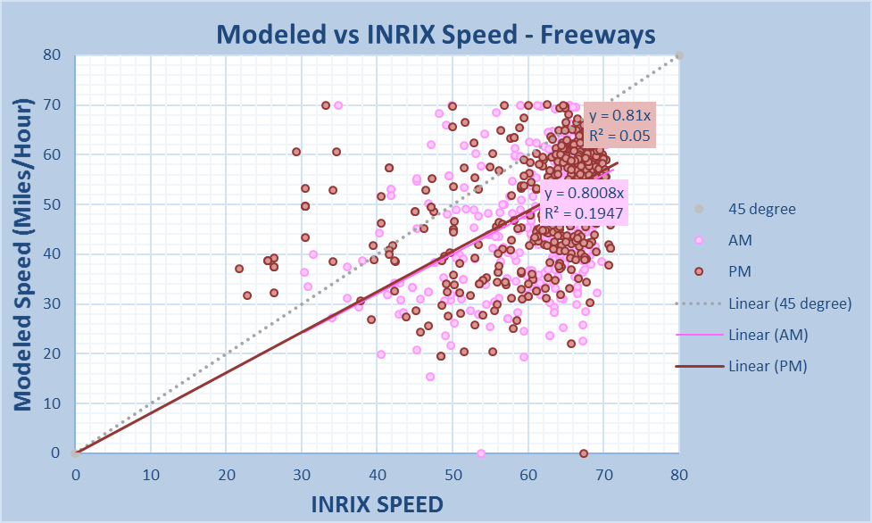
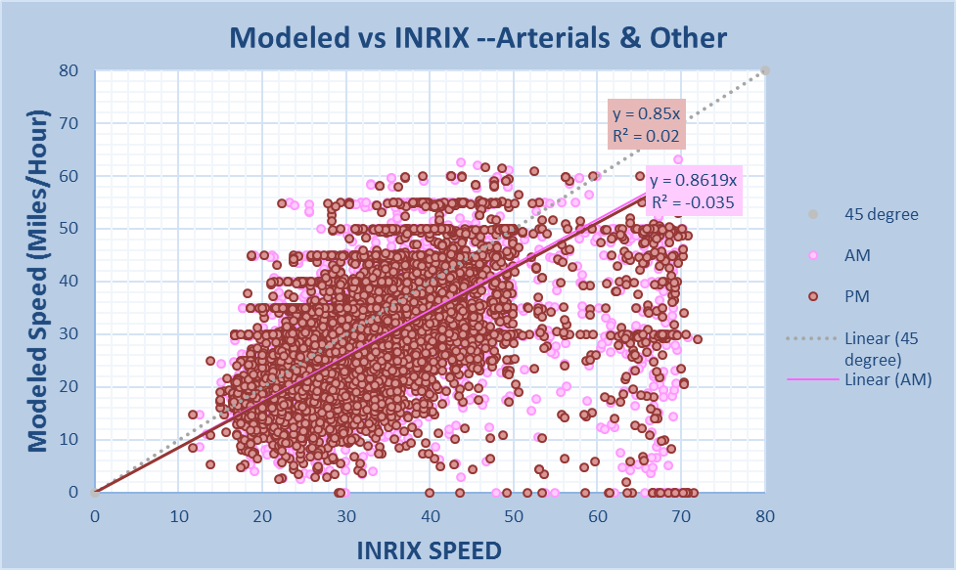
Validation Results-Before

Slide 7
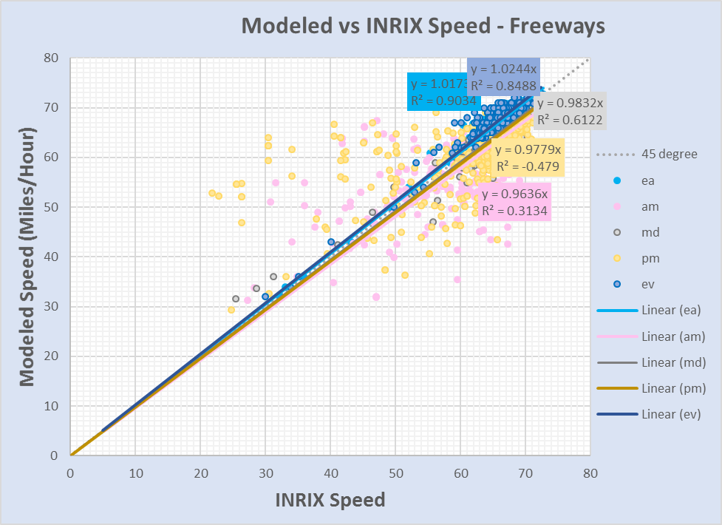
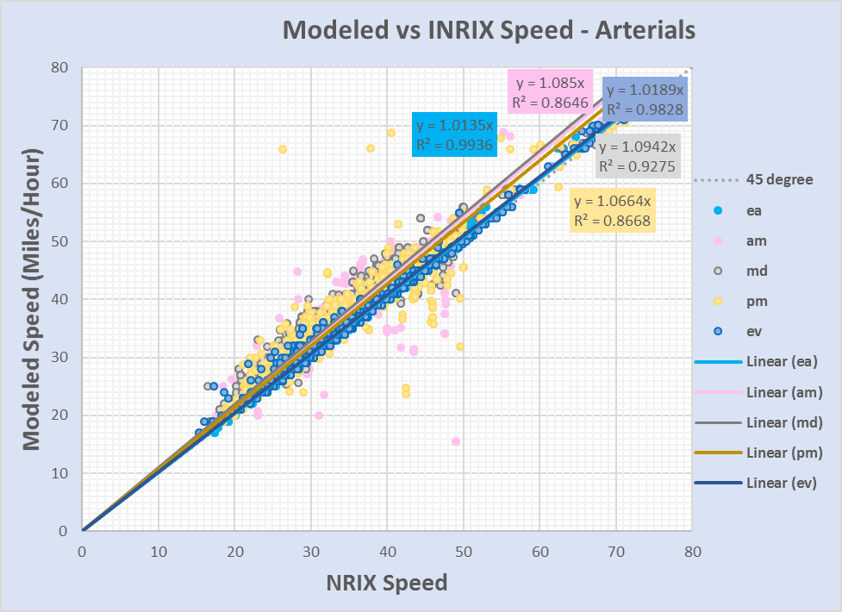
Validation Results-After

Slide 8
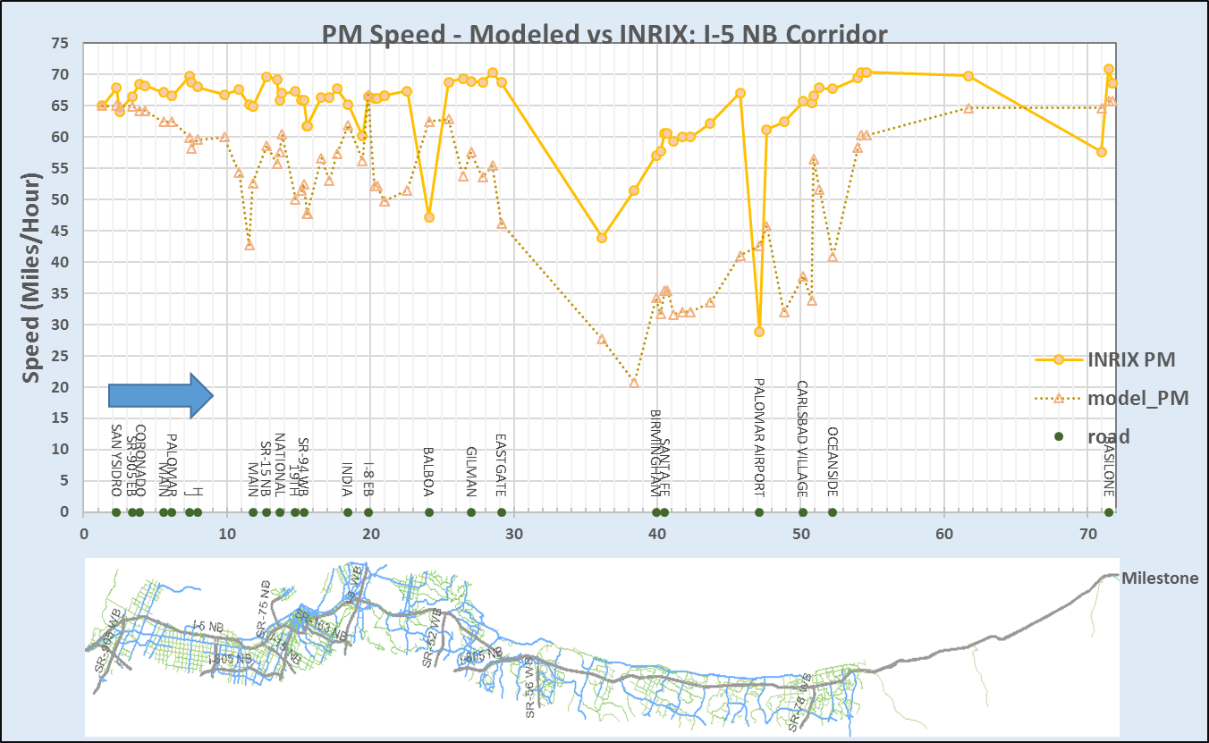
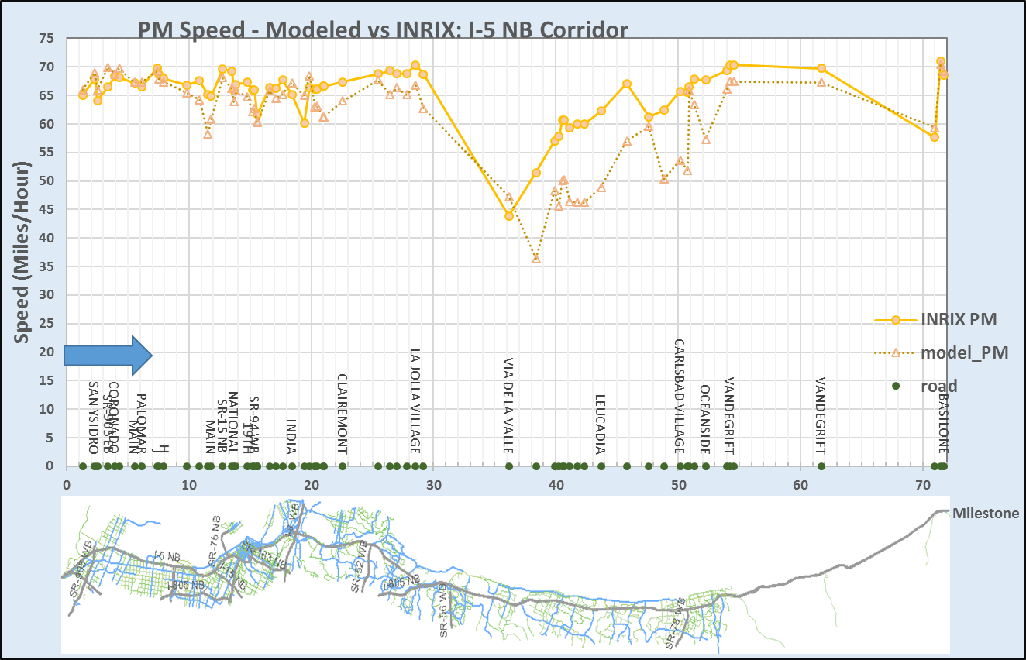
Validation Results-Freeway Corridors

Slide 9
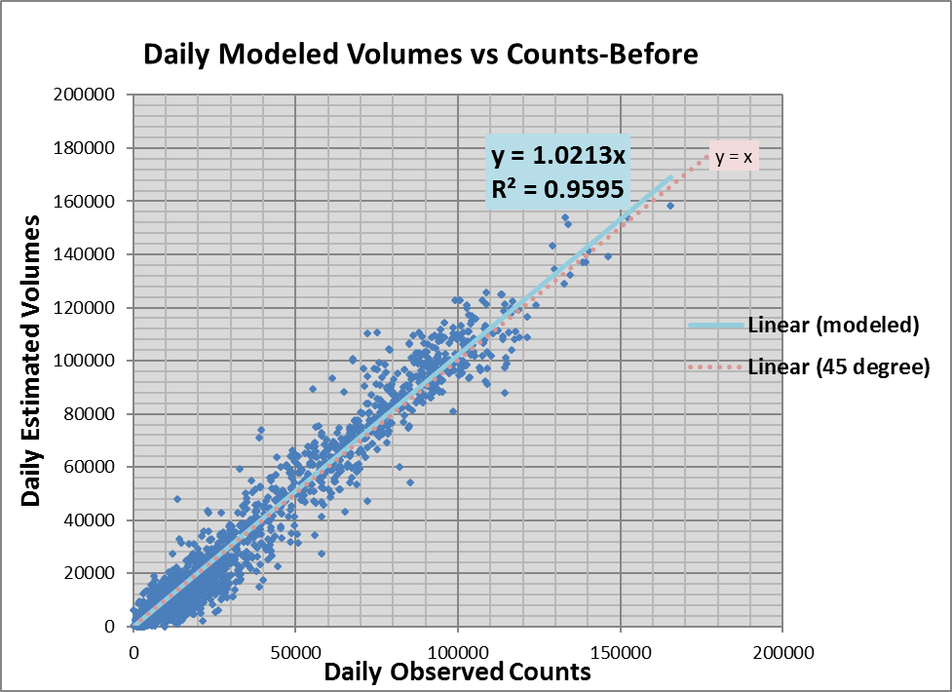
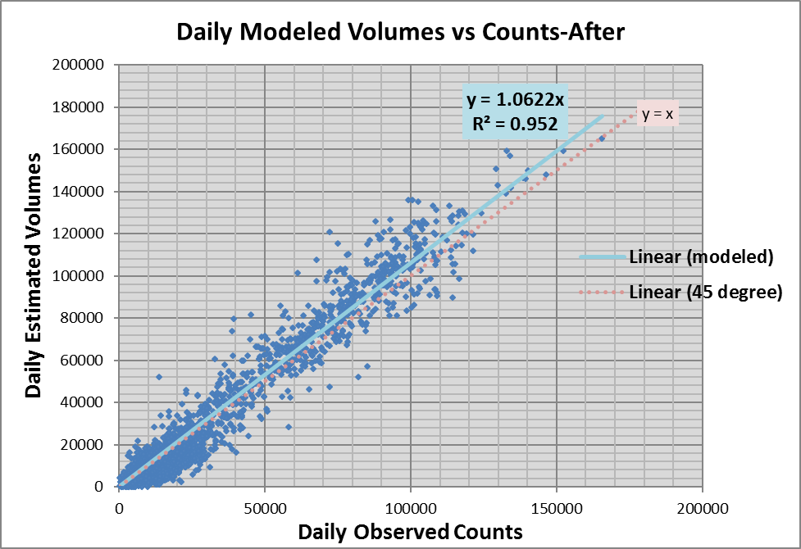
Validation Results-Traffic Volumes

Slide 10
Validation Results
Speed Validation--Freeways
 | AM |  | PM
 | Before | After | Before | After
Slope | 0.8008 | 0.9636 | 0.81 | 0.9779
R² | 0.1947 | 0.3134 | 0.05 | -0.479
Volume Validation—All Road Classes
 | Daily
 | Before | After
Slope | 1.0213 | 1.0622
R² | 0.9595 | 0.952

Slide 11
Conclusions
Big data are useful for speed calibration & validation in an Activity-Based Model
With calibrated VDF curve, the SANDAG experiment showed:
Improved speed validation results on both freeways and arterials; however, the results are not convincing
Slightly deteriorated traffic volume validation results; calibrated VDF from big data sources should be used with caution

